Slide 1

Alta Wireless Dry Contact Sensor (Industrial)

Slide 2
Introduction
ALTA Wireless Dry Contact Sensors can be used to detect contact between two wired contact points, an external mechanical switch or a contact plate.
1 ft (12 inch) lead wires
Can integrate with switches

Slide 3
Principle of Operation
The ALTA Wireless Dry Contact Sensor detects when there is contact between the two wired end points.
It can easily be integrated into existing switches or contact plates.
When the sensor detects contact between the two end points, it will immediately turn on the RF radio and transmit the data to the wireless gateway and iMonnit Online Sensor Monitoring and Notification System, allowing the user to immediately receive an SMS text or email alert.
The sensor can be configured to detect both closed and open loops alerting if contact is made or broken and alert on state changes.

Slide 4
Example Applications
Barn door monitoring
Freezer/cooler door monitoring
Forklift seat switches
Button or switch integration
Production line tracking

Slide 5
Features
Wireless range of 1,200+ feet through 12+ walls
Frequency-Hopping Spread Spectrum (FHSS) - Improved interference immunity
Improved power management for longer battery life
Encrypt-RF Security
Onboard data memory stores up to 512 readings per sensor: - 10-minute heartbeats = 3.5 days - 2-hour heartbeats = 42 days
Over-the-air updates (future proof)
Free iMonnit basic online wireless sensor monitoring and notification system to configure sensors, view data and set alerts via SMS text and email

Slide 6
Setup and Installation
Step 1:
Add the sensor on iMonnit. Add the sensor to your account by choosing Sensors in the main menu. Navigate to the Add Sensor button.
. Find the device ID. The Device ID (ID) and Security Code (SC) are necessary to add a sensor. These can both be located on the label on the side of your device.
Adding your device. You will need to enter the Device ID and the Security Code from your Sensor in the corresponding text boxes. Use the camera on your smartphone to scan the QR code on your device.
If you do not have a camera on your phone, or the system is not accepting the QR code, you may enter the Device ID and Security Code manually.
The Device ID is a unique number located on each device label. Next, you’ll be asked to enter the Security Code from your device. A security code consists of letters and must be entered in upper case (no numbers). It can also be found on the barcode label of your device.
When completed, select the Add Device button.

Slide 7
Setup and Installation
Step 2: Setup
Select your use case. Choose from the list or create your own custom settings. You will see the heartbeat interval, and aware state settings. Select the Skip button when completed.
Step 3: Validation
Check your signal. The validation checklist will help you ensure your sensor is communicating with the gateway properly and you have a strong signal.
Step 4: Actions
Choose your actions. Actions are the alerts that will be sent to your phone or email in the event of an emergency.
Industrial sensors come shipped with a 3.6V Lithium battery already installed. They do not need to be taken apart for battery installation and are not rechargeable.

Slide 8
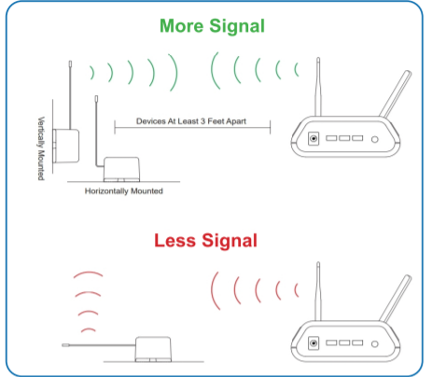
Antenna orientation
In order to get the best performance out of your ALTA Wireless Sensors, it is important to note proper antenna orientation and sensor positioning.
Antennas should all be oriented in the same direction, pointing vertically from the sensor.
If the sensor is mounted flat on its back on a horizontal surface, you should bend the antenna as close to the sensor housing as possible giving you the most amount of antenna pointing vertical.
You should make the antenna wire as straight as possible, avoiding any kinks and curving of the wire.
Sensors must be at least 3 ft. away from other sensors and the wireless gateway to function.

Slide 9

Sensor Overview In iMONNIT
Select Sensors from the main navigation menu on iMonnit to access the sensor overview page and begin making adjustments to your Advanced Vibration Meter.
A. Details - Displays a graph of recent sensor data.
B. History - List of all past heartbeats and readings.
C. Events - List of all events attached to this sensor.
D. Settings - Editable levels for your sensor.
E. Scale - Set the scale your sensor will take readings at
Directly under the tab bar is an overview of your sensor. This allows you to see the signal strength and the battery level of the selected sensor. A coloured dot in the left corner of the sensor icon denotes its status.
Green indicates the sensor is checking in and within user-defined safe parameters.
Red indicates the sensor has met or exceeded a user-defined threshold or triggered event.
Grey indicates that no sensor readings are being recorded, rendering the sensor inactive.
Yellow indicates that the sensor reading is out of date, due to perhaps a missed heartbeat check-in.

